Slide 1


Deaf Studies workshop
WFD Youth Section and EUDY (international organizations)
Events and Organizations by and for Deaf people
Funded by the European Union. Views and opinions expressed are however those of the author(s) only and do not necessarily reflect those of the European Union or the European Education and Culture Executive Agency (EACEA). Neither the European Union nor EACEA can be held responsible for them.

Slide 2
Index
  Introduction of the WFD Youth Section
  Introduction of the EUDY
  Introduction of the Frontrunners
  Group work presentation
  Final group discussion

Slide 3

WFDYS
The World Federation of the Deaf Youth Section (WFDYS) is the youth section of the World Federation of the Deaf (WFD).
represents the interests of young deaf people worldwide
advocates for their rights, education, and social inclusion
Notes:
It represents the interests of young deaf people worldwide and advocates for their rights, education, and social inclusion.

Slide 4

Main Goals of WFDYS:
Promotion of Sign Languages – WFDYS advocates for the recognition and protection of national sign languages as a human right.
Strengthening Youth Participation – The organization encourages young deaf people to engage in their communities and at the international level.
Education and Empowerment – Through training, conferences, and youth camps, WFDYS enhances the skills and confidence of young deaf individuals.
International Cooperation – WFDYS connects young deaf people globally to discuss common challenges and develop solutions.
Human Rights and Inclusion – WFDYS collaborates with international organizations to promote the rights of deaf youth worldwide.
The organization works closely with the World Federation of the Deaf (WFD), the United Nations (UN), and other global organizations to represent the interests of young deaf people on an international level.
WFDYS
Notes:
who make up the organisations? Hearing or deaf? What different? How look Deaf leadership like, different from hearing leadership?

Slide 5
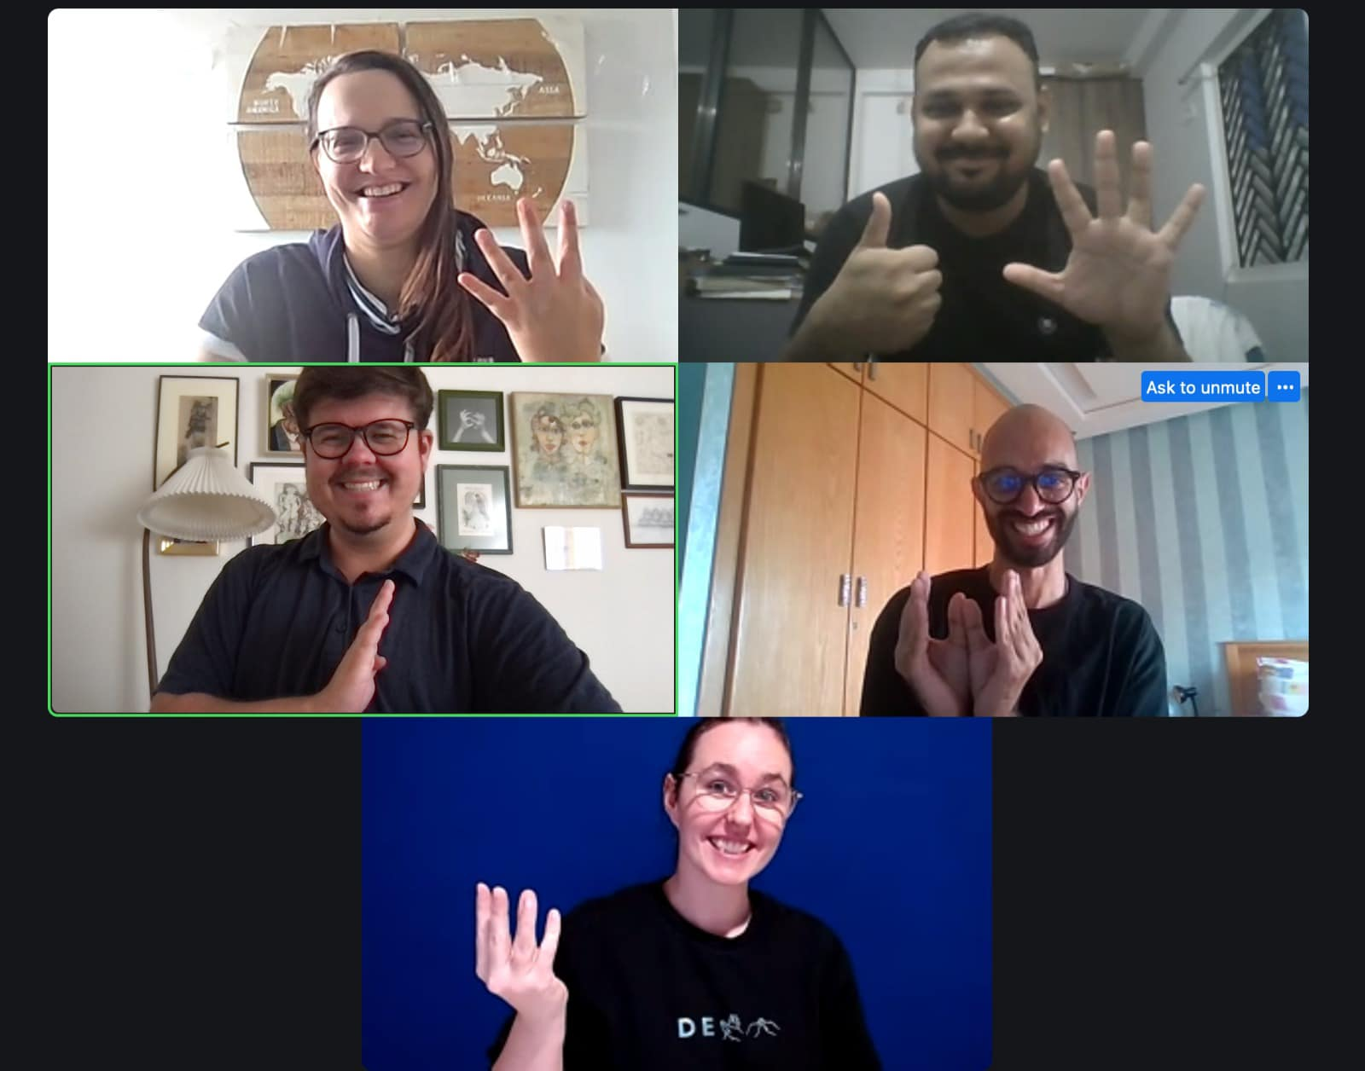

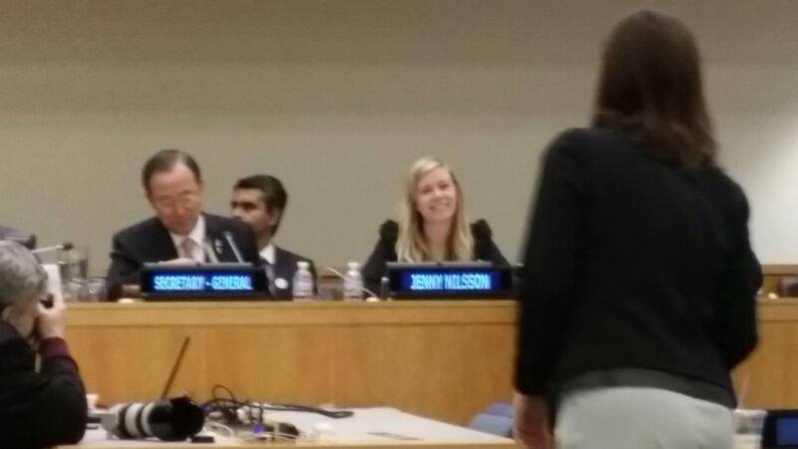



activities
WFDYS
Meeting at UN Headquarters
WFDYS Board Meeting online
Unicef meeting
Workshop with children
Workshop with Tunisian youth
Scoure: www.facebook.com/wfdys and www.instagram.com/wfdys
Notes:
who make up the organisations? Hearing or deaf? What different? How look Deaf leadership like, different from hearing leadership?

Slide 6

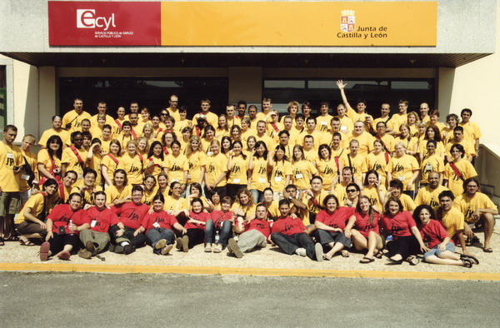
International Camp
WFDYS
Children Camp
Junior Camp
Youth Camp
9 to 12 years old
13 to 17 years old
18 to 30 years old
The Camp is the most valuable to empower the children to youth campers and
COC that grow up and experience how to manage!
Scoure: www.facebook.com/wfdys and www.instagram.com/wfdys
Notes:
who make up the organisations? Hearing or deaf? What different? How look Deaf leadership like, different from hearing leadership?

Slide 7

EUDY
The European Union of the Deaf Youth (EUDY) is an organization that represents the interests of young deaf people in Europe.
advocates for the rights, education, and social inclusion of deaf youth
promotes exchange between different countries

Slide 8
Main Goals of EUDY:
Promotion of Sign Languages – EUDY advocates for the recognition and use of national sign languages across Europe.
Youth Participation – The organization supports young deaf people in becoming politically and socially engaged.
Education and Empowerment – Through workshops, conferences, and youth camps, EUDY strengthens the self-confidence and skills of deaf youth.
International Networking – EUDY brings together young deaf people from different European countries to foster exchange and collaboration.
Education and Empowerment – Through training, conferences, and youth camps
Diverse - aiming to raise awareness, educate, empower and stand up for those who identify as LGBTQIA+, Deaf Women, Deafblinds, Deaf BIPOC, various religious groups, etc.
The organization collaborates with national deaf associations and the European Union of the Deaf (EUD) to strengthen the rights of young deaf people at the European level.
EUDY
Notes:
who make up the organisations? Hearing or deaf? What different? How look Deaf leadership like, different from hearing leadership?

Slide 9





activities
EUDY
EUDY General Assembly
European Deaf Youth Capital (EDYC)
activites
European Youth Forum
Presentation/Interview on Instagram LIVE
Source: www.instagram.com/eudy_ofc
Notes:
who make up the organisations? Hearing or deaf? What different? How look Deaf leadership like, different from hearing leadership?

Slide 10



International Camp
EUDY
Children Camp
Junior Camp
Youth Camp
9 to 12 years old
13 to 17 years old
18 to 30 years old
The Camp is the most valuable to empower the children to youth campers and
COC that grow up and experience how to manage!
Notes:
who make up the organisations? Hearing or deaf? What different? How look Deaf leadership like, different from hearing leadership?

Slide 11

Frontrunners
Frontrunners is an international education and leadership program for deaf young adults based in Denmark.
It provides intensive training on topics such as deaf rights, leadership, media, sign languages, and project management.
Scoure: www.frontrunners.dk

Slide 12
Key Facts About Frontrunners:
The program was founded in 2005 and takes place at Castberggård, an education center for deaf people in Denmark.
It is designed for young deaf individuals from around the world who are passionate about social change and strengthening the deaf community.
The courses are taught in International Sign (IS) to enable communication among participants from different countries.
The program includes different modules, such as module 1 (Leadership & Community Building) and
module 2 (Advanced Specialization & Project Work).
Many graduates go on to work in national and international deaf organizations.
Frontrunners
Scoure: www.frontrunners.dk
Notes:
who make up the organisations? Hearing or deaf? What different? How look Deaf leadership like, different from hearing leadership?

Slide 13






activities
Frontrunners
Deaf teachers
Sport activities
workshop
group work
lesson
discussion
Notes:
who make up the organisations? Hearing or deaf? What different? How look Deaf leadership like, different from hearing leadership?

Slide 14

Final group discussion
Notes:
Questions:
Who makes up the organizations? Are they composed of hearing or Deaf individuals? What are the differences?
What does Deaf leadership look like? How is it different from hearing leadership?
Distinction between organizations 'of,' 'for,' and 'by' the Deaf

Slide 15








Contact
https://www.deafstudies.eu/
Deaf Culture, Heritage and Diversity
@deafstudies.eu

