Slide 1


Deaf Studies - Workshop
Deaf Education
Higher Education – Deaf Students
Sources | Pictures:
freepik.com
Funded by the European Union. Views and opinions expressed are however those of the author(s) only and do not necessarily reflect those of the European Union or the European Education and Culture Executive Agency (EACEA). Neither the European Union nor EACEA can be held responsible for them.

Slide 2

Welcome
  Indroduction
  Icebraker

Slide 3
Content Overview
  • Objectives
  • Legal framework
  • Obstacles and barriers
  • Support
  • Strategies and solutions
  • Guidelines for universal learning (barrier-free)
  •Self-advocacy (3 examples)

Slide 4

Goals
  - Knowledge of legal frameworks
  - Knowedge of support measures
  - Importance of self-advocacy and autonomy for Deaf students
  - Knowledge about inclusion in higher education

Slide 5


Legal Framework
Higher education laws
Commitment to accessibility and support
General Equal Treatment Act
Protection against discrimination on the basis of disability
UN-UN Convention on the Rights of Persons with Disabilities (UN CRPD)
international
national
country
regional
institution

Slide 6


Barriers
Lack of accessibility in courses and rooms
Lack of support in communication
Insufficient awareness among staff
Unclear responsibilities and financial constraints

Slide 7

Support Measures
Sign language interpreters in courses
assistive technologies, apps, subtitles
Accessible learning materials,
Tutors for transcripts

Slide 8
Strategies and solutions
Accessible
teaching and learning concepts
Training teaching staff
in dealing with Deaf students
Use of modern technologies
Promotion of self-advocacy

Slide 9



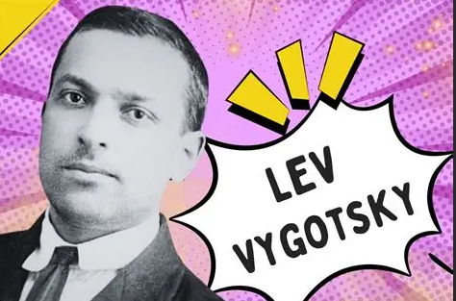
Theory Background - Education & Language
Vygotsky’s socio-cultural learning theory
“The ability to express oneself
in any environment,
especially in the classroom,
is crucial for intellectual development.”
russischer Psychologe
1886 – 1934, Moskau
Bildungs- und Entwicklungspsychologie
Models of accessibility
Language Diverstiy in the Classroom
Source: Lev Vygotsky's Instagram, Twitter & Facebook on IDCrawl

Slide 10

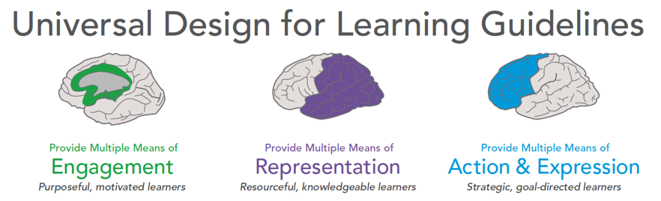

Finding Practical Examples
Activity
CAST Universal Design for Learning Guidelines
WHY
Stimulate interest and motivation for learning
WHAT
Present information and content in different ways
HOW
Differentiate the ways that students can express what they know

Slide 11

Finding Practical Examples for the Deaf
Activity
CAST Universal Design for Learning Guidelines

Slide 12





Promotion of self-determination, Example 1
European
Level
Home | European Deaf Students' Union

Slide 13



Promotion of self-determination
International
Level
Dr Deaf – Acadeafic
cross-disciplinary international Deaf space
strengthen deaf academics an their careers
workshops between experienced and new Deaf academics,

Slide 14

Promotion of self-determination, Example 3
National
Level
Association of Austrian Deaf Students
Peer-to-peer counselling

Slide 15

Promotion of self-determination, Example 4
Regional
Level
Support, Universities in Vienna an Graz
GESTU organises and coordinates services
for Deaf students
Sign language interpreters
Speech-to-text interpreters
Note-takers for classes
GESTU provides advice and support for University Staff
Servicestelle GESTU Wien stellt sich vor

Slide 16

Fazit
The rights of deaf students are statet in various laws
(international, national, regional).
Accessible and inclusive learning environments promote equal opportunities.
Good networks of deaf students promote accessibility.
The goal is to develop self-determined students.
Stand up for your rights!

Slide 17








Contact
https://deafstudies.eu/
Deaf Culture, Heritage and Diversity
@deafstudies.eu

