Slide 1


Deaf Studies | Workshop
Deaf Education
Deaf education - Deaf didactics
Funded by the European Union. Views and opinions expressed are however those of the author(s) only and do not necessarily reflect those of the European Union or the European Education and Culture Executive Agency (EACEA). Neither the European Union nor EACEA can be held responsible for them.
Sources Pictures:
freepik.com

Slide 2



Welcome
  Introduction
  Icebreaker

Slide 3

Contents - Overview
- Info: Deaf education, UN-Konvention
- Brainstorming: Deaf didactics
- Info: Deaf didactics principles
- Activity: Create a project week
- Conclusion
- Feedback

Slide 4

Goals
Understanding the connection between
- education
- language
- inclusion
- culture.

Slide 5



Deaf education
our
rights
UN Convention on the
Right of Persons with Disabilities,
Article 24
Right to sign language for
Deaf and hearing-impaired pupils/students

Slide 6

Deaf Education - Right to sign language
equal participation in the education system
barrier-free education
non-discriminatory education
inclusive education
unsere
Rechte

Slide 7




Deaf education – Deaf Didactics
didactics = how to teach
Deaf didactics = how to teach Deaf pupils

Slide 8



Brainstorming – Deaf Didactics
Deaf Didactics = how to teach Deaf pupils
Imagine you are a teacher.
How would you teach
in a classroom
With dDaf and hearing
pubils?
Activity

Slide 9



Info: Deaf Didactics - Principles
bilingual & bimodal
including
Sign Language
Deaf teachers
(native signer)
hearing teachers
can sign
visual learning aids
(materials, videos)
environment:
seating arrangement,
light system
Sign language
Inter´preter
Curriculum also includes
Deaf Culture
(History, Arts, Movies …)
Group work, projects
(commuication with each other in both languages)
Deaf Community
Workshops, events with Deaf guests

Slide 10
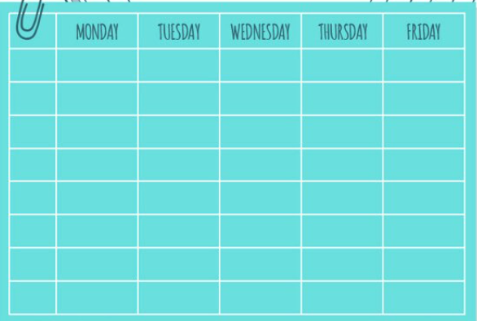
Create a project week
In the classroom are
Deaf an hearing students.
The teacher ask the deaf students to create a project week with the topic Deaf Culture and Deaf Community.
Activity

Slide 11
Create a project week – ideas, tips
Sign Language
Why is it important for us?
Guests
Taube Role Models
Excursions to the
Deaf Community
What will you show?
Deaf History
important examples
Guests
Taube Role Models
Deaf Culture
Art, Movies …
Activity
Sign Language
Why is it important for us?What
Sign Language
Why is it important for us?
What else is important for you
?
Interpreters
How does it work?
Communication Rules
Examples

Slide 12

Conclusion
- Deaf education requires sign language!
- bilingual, bimodal
- Deaf didactics
- attention to room design (be able to SEE each other, good light,
visual alarm systems …)
- Embedding Deaf culture in the schools
- Connection with the Deaf community

Slide 13

Feedback
Feedback
Thank you for your attention!

Slide 14








Contact
https://deafstudies.eu/
Deaf Culture, Heritage and Diversity
@deafstudies.eu

