Slide 1


Deaf Studies | Workshop
Deaf Role Models and
Leadership
Deaf Activism and Advocacy
Funded by the European Union. Views and opinions expressed are however those of the author(s) only and do not necessarily reflect those of the European Union or the European Education and Culture Executive Agency (EACEA). Neither the European Union nor EACEA can be held responsible for them.
Sources Pictures:
freepik.com
equalizent

Slide 2




Welcome
  Introduction
  Ice Breaker

Slide 3

Content - Overview
  Introduction
  Beginnings
  Civil rights movement
  Technological progress
  Significance today
  Role Models
  Action days
  Summary and outlook
  Conclusion and discussion
  Feedback

Slide 4


Learning Goals
- Understanding the history of Deaf representatives
- Knowing important milestones in Deaf activism
- Role Models Gallery – activists
- Understanding and respect for one's own culture, values, and needs
- Knowledge of important organizations (local, regional, international)
- Strengthening one's own commitment.

Slide 5

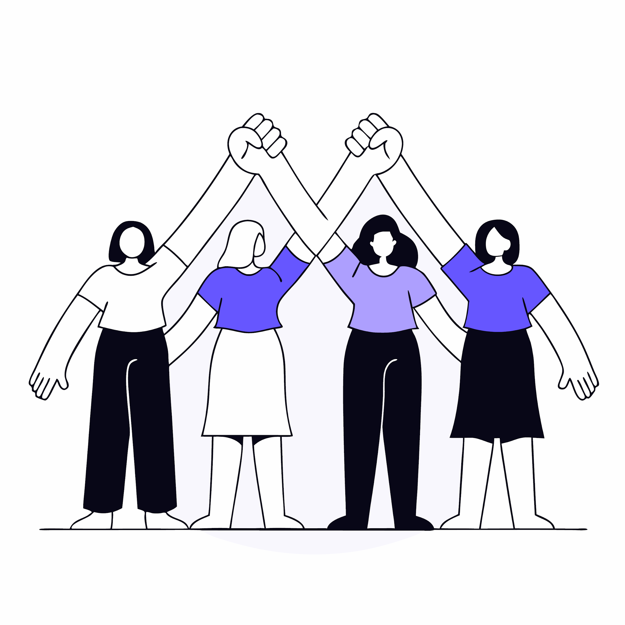
Info: Activism and Deaf Community
Throughout history, Deaf people have fought for their
- rights
- culture
- self-determination
The activism is characterized by
- desire for equality
- recognition of sign language
- cultural autonomy

Slide 6


Important Milestones
Sign Language
Education Rights
  Technological Progress
Global
Networking

Slide 7







Beginnings - 19. and early 20. Century
Foundation of associations and federations, especially in Europe and the USA
Example: National Association of the Deaf (NAD), USA, 1880
Contents / Situation:
-Sign language instead of lip reading
- Many Deaf people were excluded from the education system
or isolated in specialized institutions..

Slide 8

Cultural Movement
Sign Language Activism (1920–1960)
Willism Stokoe
Turning point:
Sign Language = independent language
  1960: William Stokoe
  publishes the groundbreaking work Sign Language Structure
  = Linguistic recognition of sign language
  = Promotion of the protection of sign languages
  = Foundation of sign language movements
  Movement: Sign language as part of cultural identity
  Activism: Demand for recognition and self-determination

Slide 9


Civil Rights Movement of the 1960s and 1970s
Fight for equality:
- US ADA (Americans with Disabilities Act)
= Legal regulations for people with disabilities
- Demand for access to education, employment, politics, and culture.
“Deaf President Now” (DPN) 1988:
- Protest movement at Gallaudet University in Washington, D.C.
- Students demand the election of a Deaf president — a significant success!
Self-advocacy — Respect — Sign Language —
Founding organizations — “Nothing about us without us!”

Slide 10


Digitalization: Technological Progress
Technology:
- Subtitles
- Video apps
- Internet – worldwide connection
- KI
Sign language interpreters on site and online

Slide 11







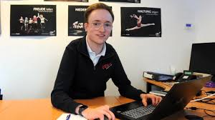


Role Models Gallery
Politics, Economy, Technology
Activity
Activity

Slide 12



Info: Significance of Deaf Activism today
The movement has contributed significantly to sign language now
being recognised as a language in its own right.
Raising awareness of the cultural identity of the Deaf community.
Deaf people today are working in the worlds of politics,
science, art and media — as role models and ambassadors
for their culture.
Commitment to inclusive societies, accessibility and
self-advocacy

Slide 13


Global Networking
Activity
World Federation of the Deaf
World Federation of the Deaf | Inclusion & Equal Rights
Home - EUDY

Slide 14


Present and current challenges
  Progress
  - legal recognition of sign language in many countries.
  - greater visibility in the media, politics and culture.
Challenges
  - unequal power relations
  - lack of accessibility
  - social prejudices
  Continue fighting for full access
  - in public spaces,
  - in education,
  - work and the media.

Slide 15




Action-Days

Slide 16

Create your own Action Day!
What’s your message &
vision?

Slide 17

Conclusion & Future
History of Deaf Activism
= Courage – Creativity - Commitment to Equality
Success stories such as the Gallaudet protest
show how self-confident activism brings about change.
The fight for full recognition, visibility, and accessibility continues!
Future:
- greater empowerment
- technological innovations
- global networking
- greater social acceptance.

Slide 18

Feedback
Thank you for your attention!!

Slide 19






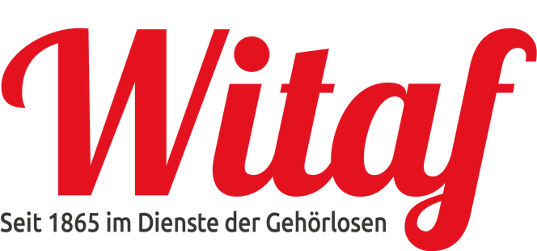

Kontakt
https://deafstudies.eu/
Deaf Culture, Heritage and Diversity
@deafstudies.eu

