Slide 1


Deaf Studies workshop
Mental Health and Well-being
Mental Health Resources for Deaf People

Slide 2





What is Mental Health?
How We Think
How We Feel
Our thoughts and feelings matter
Everyone experiences emotions
Everyone Has Mental Health
How We Connect
It's part of being human
Relationships with others are important
Source: Image generated by ChatGPT

Slide 3

Key Mental Health Terms
Stress 😣
Anxiety 😟
Depression 😞
Source: Image generated by ChatGPT
Bullying 🚫😠

Slide 4
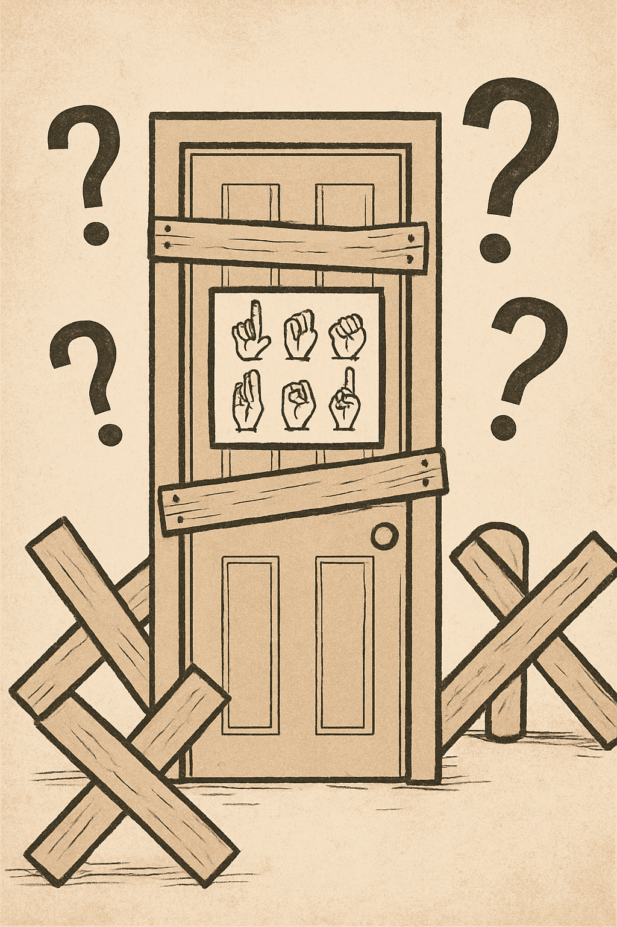
Challenges for Deaf People
Communication Barriers
Feeling Isolated
Many Deaf feel alone or misunderstood by hearing services.
No interpreter available. No information in sign language. Hard to find help.
Essential Need
Sign language is essential for good mental
health support!
Source: Image generated by ChatGPT

Slide 5




Group Discussion – What Are the Barriers?
Share Your Experience
What makes it hard for Deaf people
to get help?
Communication Impact
How does communication affect
getting support?
Real Examples
Any stories or examples to share?
Source: Image generated by ChatGPT

Slide 6
Video – Deaf-Friendly Services
Watch and Learn
Discussion Points
Short video showing Deaf-friendly services. SignHealth, Deaf helplines, peer support examples.
What Deaf-friendly services did you see? What looked helpful?

Slide 7









Resource Mapping –
Where Can I Find Help?
Crisis Lines
Counselling
Emergency text
and video support
Professional therapy services
Online Help
Peer Support
Digital resources
and support
Groups with shared experiences

Slide 8

Source: Image generated by ChatGPT
Share & Network
Spread the Word
Add Your Ideas
Share information with friends and family.
Group Sharing
Contribute your own knowledge and experiences.
Each group shows one resource or tip they found.

Slide 9




Source: Image generated by ChatGPT
Remember These Important Points
It's OK to Ask
Contact Services
Seeking help is normal and brave
Reach out to Deaf-friendly support
You're Not Alone
Support is available for you

Slide 10


Thank You!
✓
🤝
Information Shared
Community Built
You now have resources
Help by sharing with others
📧
Stay Connected
Questions? Contact us anytime
Source: Image generated by ChatGPT

Slide 11








Contact
https://deafstudies.eu/
Deaf Culture, Heritage and Diversity
@deafstudies.eu

