Slide 1


Deaf Studies | Workshop
Deaf Role Models and
Leadership
Deaf Activism and Advocacy
Sources Pictures:
freepik.com
equalizent

Slide 2




Welcome
  Introduction
  Ice Breaker

Slide 3

Content - Overview
  Introduction
  Beginnings
  Civil rights movement
  Technological progress
  Significance today
  Role Models
  Action days
  Summary and outlook
  Conclusion and discussion
  Feedback

Slide 4
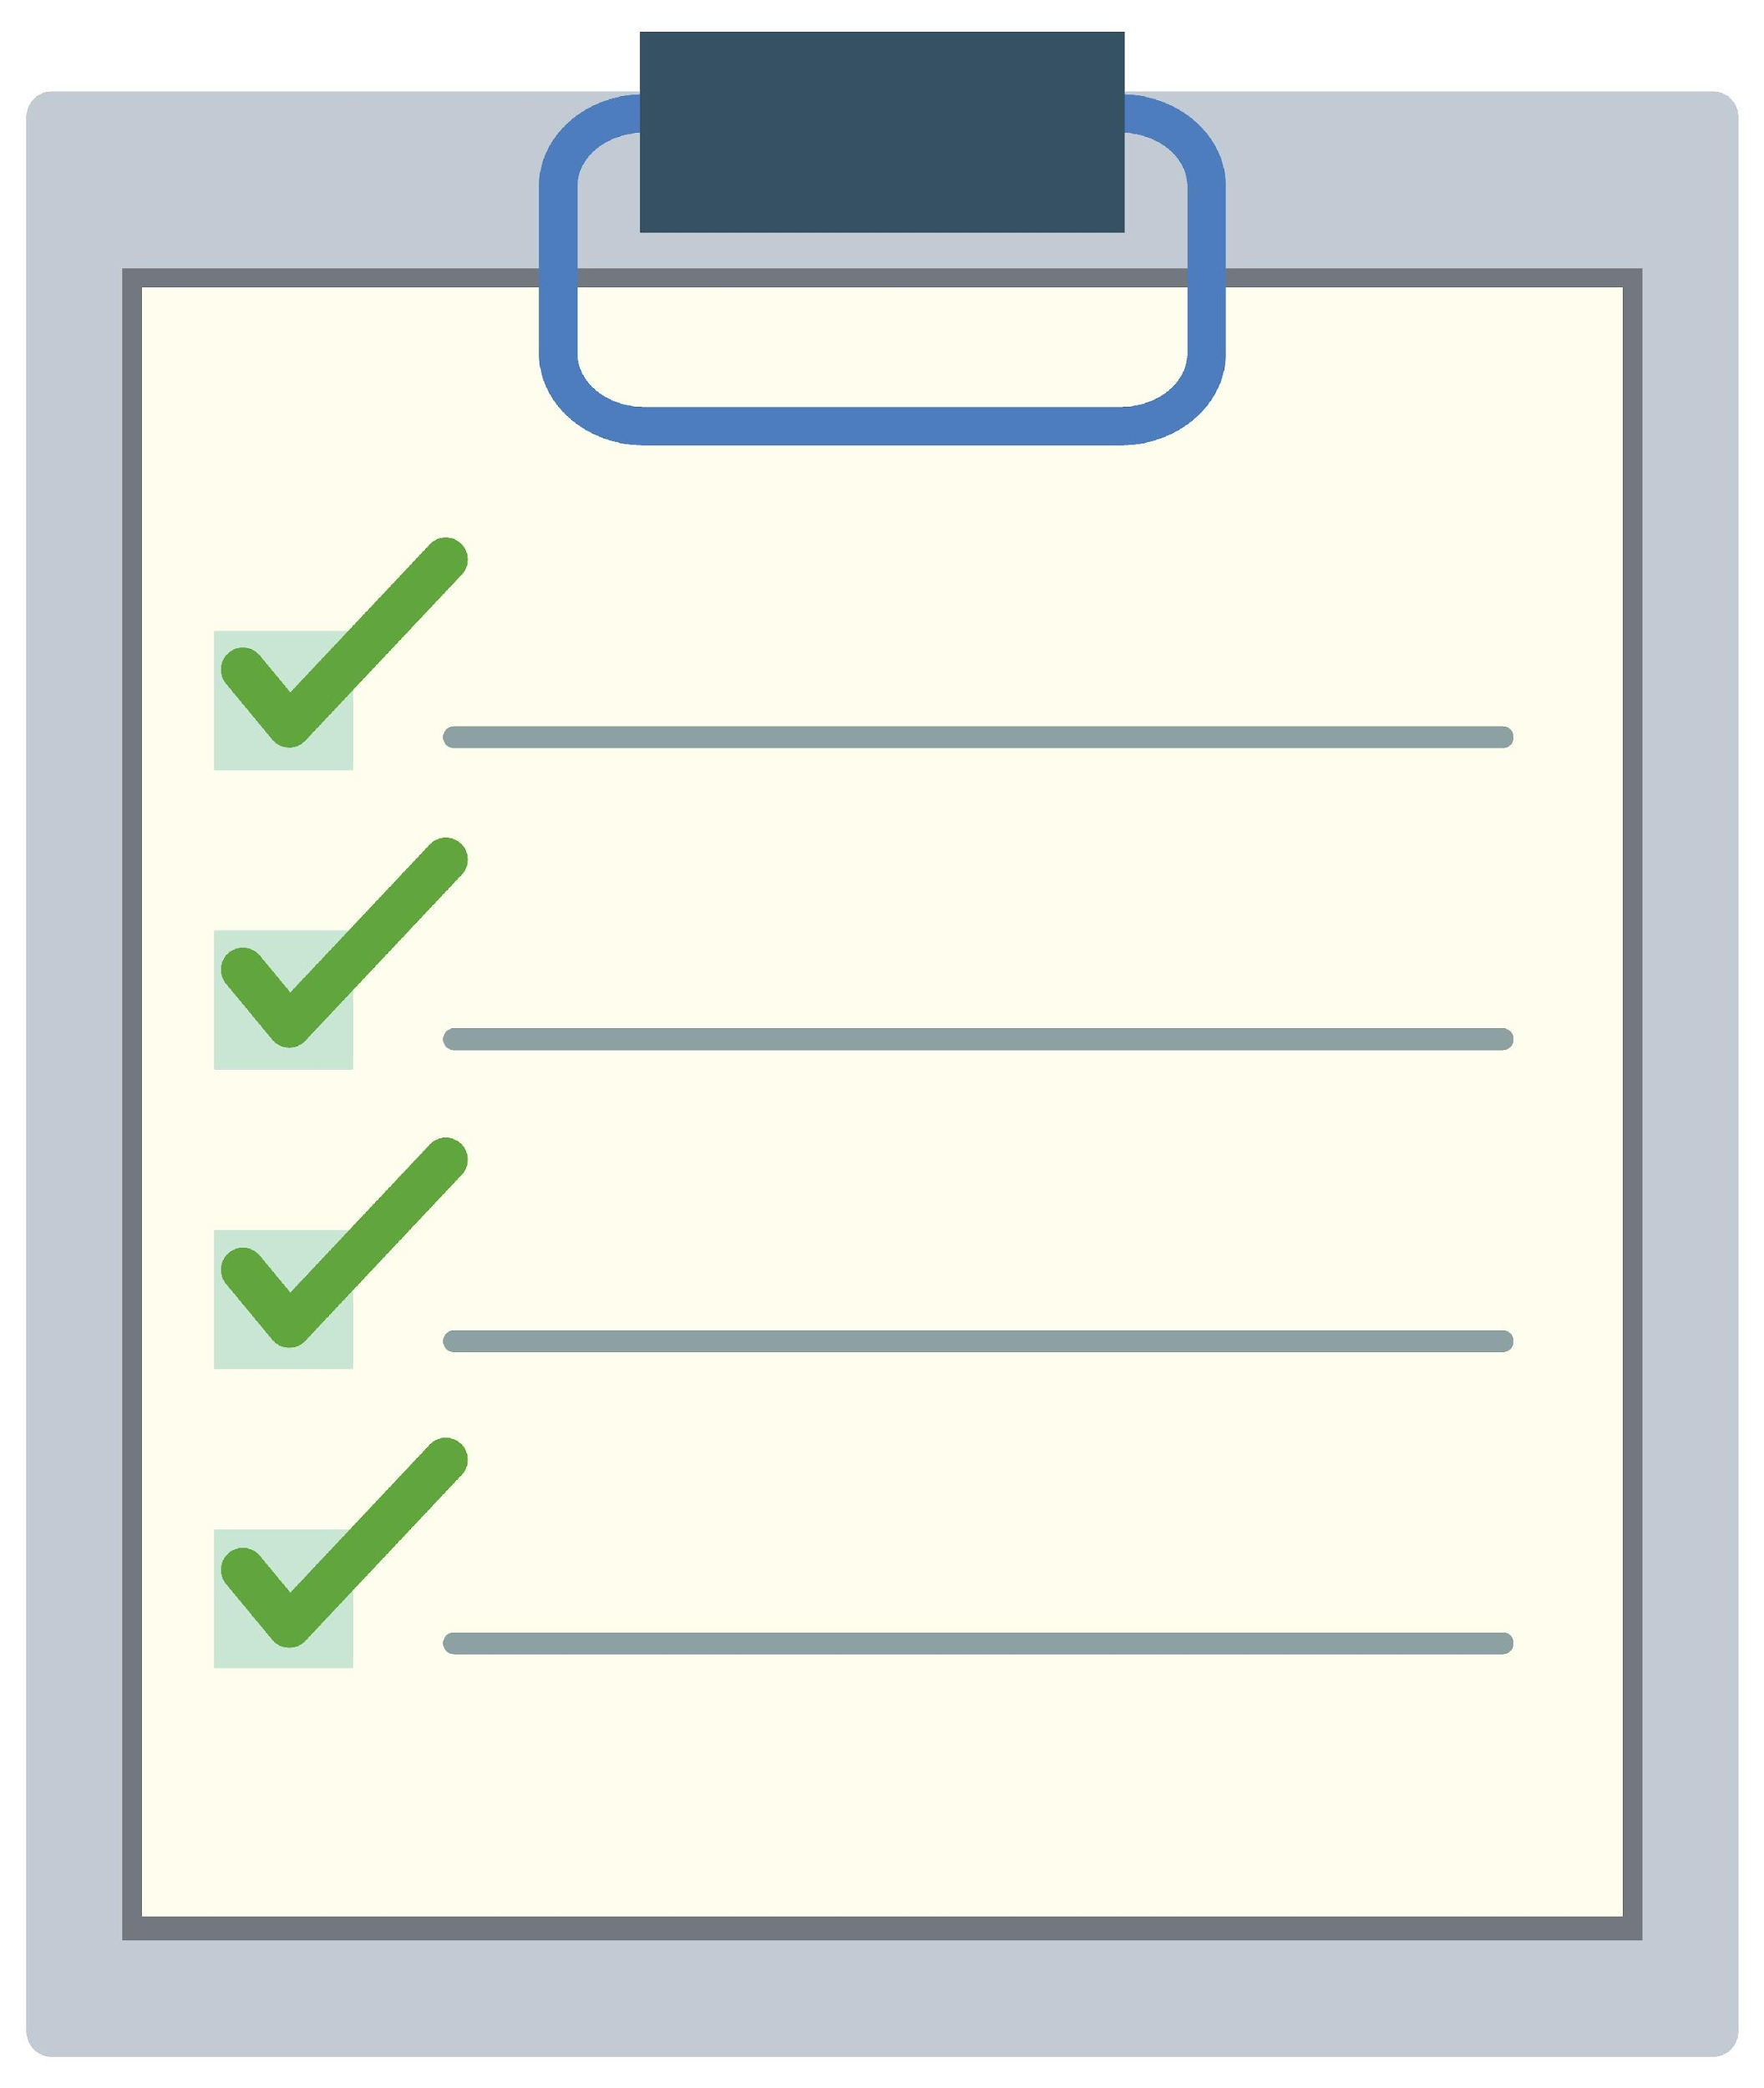

Learning Goals
- Understanding the history of Deaf representatives
- Knowing important milestones in Deaf activism
- Role Models Gallery – activists
- Understanding and respect for one's own culture, values, and needs
- Knowledge of important organizations (local, regional, international)
- Strengthening one's own commitment.

Slide 5


Info: Activism and Deaf Community
Throughout history, Deaf people have fought for their
- rights
- culture
- self-determination
The activism is characterized by
- desire for equality
- recognition of sign language
- cultural autonomy

Slide 6


Important Milestones
Sign Language
Education Rights
  Technological Progress
Global
Networking

Slide 7







Beginnings - 19. and early 20. Century
Foundation of associations and federations, especially in Europe and the USA
Example: National Association of the Deaf (NAD), USA, 1880
Contents / Situation:
-Sign language instead of lip reading
- Many Deaf people were excluded from the education system
or isolated in specialized institutions..

Slide 8

Cultural Movement
Sign Language Activism (1920–1960)
Willism Stokoe
Turning point:
Sign Language = independent language
  1960: William Stokoe
  publishes the groundbreaking work Sign Language Structure
  = Linguistic recognition of sign language
  = Promotion of the protection of sign languages
  = Foundation of sign language movements
  Movement: Sign language as part of cultural identity
  Activism: Demand for recognition and self-determination

Slide 9


Civil Rights Movement of the 1960s and 1970s
Fight for equality:
- US ADA (Americans with Disabilities Act)
= Legal regulations for people with disabilities
- Demand for access to education, employment, politics, and culture.
“Deaf President Now” (DPN) 1988:
- Protest movement at Gallaudet University in Washington, D.C.
- Students demand the election of a Deaf president — a significant success!
Self-advocacy — Respect — Sign Language —
Founding organizations — “Nothing about us without us!”

Slide 10


Digitalization: Technological Progress
Technology:
- Subtitles
- Video apps
- Internet – worldwide connection
- KI
Sign language interpreters on site and online

Slide 11



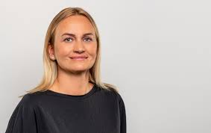



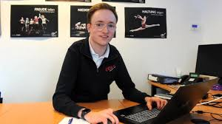


Role Models Gallery
Politics, Economy, Technology
Activity
Activity

Slide 12



Info: Significance of Deaf Activism today
The movement has contributed significantly to sign language now
being recognised as a language in its own right.
Raising awareness of the cultural identity of the Deaf community.
Deaf people today are working in the worlds of politics,
science, art and media — as role models and ambassadors
for their culture.
Commitment to inclusive societies, accessibility and
self-advocacy

Slide 13


Global Networking
Activity
World Federation of the Deaf
World Federation of the Deaf | Inclusion & Equal Rights
Home - EUDY

Slide 14


Present and current challenges
  Progress
  - legal recognition of sign language in many countries.
  - greater visibility in the media, politics and culture.
Challenges
  - unequal power relations
  - lack of accessibility
  - social prejudices
  Continue fighting for full access
  - in public spaces,
  - in education,
  - work and the media.

Slide 15




Action-Days

Slide 16

Create your own Action Day!
What’s your message &
vision?

Slide 17

Conclusion & Future
History of Deaf Activism
= Courage – Creativity - Commitment to Equality
Success stories such as the Gallaudet protest
show how self-confident activism brings about change.
The fight for full recognition, visibility, and accessibility continues!
Future:
- greater empowerment
- technological innovations
- global networking
- greater social acceptance.

Slide 18

Feedback
Thank you for your attention!!

Slide 19


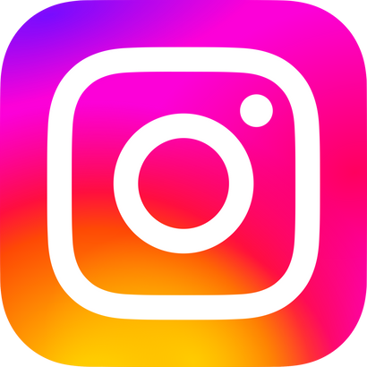





Kontakt
https://deafstudies.eu/
Deaf Culture, Heritage and Diversity
@deafstudies.eu

